Slide 1
Introduction to
Searching and Sorting
Creative Commons Attribution-NonCommercial-ShareAlike 3.0 Unported License. http://creativecommons.org/licenses/by-nc-sa/3.0/
Written by Rachel J. Morris, last updated 2016-04-10

Slide 2

Searching for Data

Slide 3
Searching
Searching is one of those tasks that is tedious and slow for a human, but can be automated by a computer.
When we're storing so much data in a database or other format, we need a way to access that data by some criteria.

Slide 4
Searching
There are different algorithms for searching.
There may be different ways to approach searching,
based on the type of data structure that you are searching,
and whether the data in that structure is sorted or not.
Ordered array
Unordered linked list
0
About
1
Above
2
Bank
3
Cake
4
Cat
Wolf
Pig
Fish
Bird

Slide 5
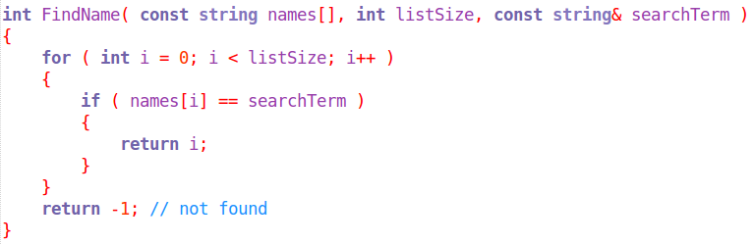
Linear Search
The easiest to implement is a search from the beginning to the end of a list, checking each item in order.
This search is pretty “dumb”. How could it be improved?

Slide 6
Thinking of strategies...
If the list is in alphabetical order, we could check the first letter, and decide to begin searching from first → last, or last → first...
Find “Wynne”
0
Alistair
1
Leilana
2
Morrigan
3
Oghren
4
Sten
5
Wynne
5
Zevran
Found on 2nd compare
Find “Morrigan”
0
Alistair
1
Leilana
2
Morrigan
3
Oghren
4
Sten
5
Wynne
5
Zevran
Found on 3rd compare

Slide 7
Thinking of strategies...
If the list is in alphabetical order, we could check the middle element, and figure out which half of the list to search based on alphabetical order...
Find “Wynne”
0
Alistair
1
Leilana
2
Morrigan
3
Oghren
4
Sten
5
Wynne
5
Zevran
Middle element is “O”, search the top of the list...
4
Sten
5
Wynne
5
Zevran
Found after 3 compares
(including checking middle element)

Slide 8
Thinking of strategies...
We could store the “names” list in a different data structure to make it easier to search for items without covering the entire list...
A
Z
Oghren
Find “Wynne”
Found on 2nd compare
Morrigan
Wynne
Leilana
Sten
Zevran
Alistair

Slide 9
Introduction to
Binary Trees

Slide 10
Intro to Trees
What if you want to store your data like this?
Notice that everything is sorted so that
left = less
right = greater
5
3
10
2
7
13
-2
This would be a Binary Tree

Slide 11
Intro to Trees
For the binary tree structure, there is a collection of nodes.
We could implement a data structure like this utilizing pointers
Each node in a binary tree can have 0, 1, or 2 children
(but no more than that)
5
Each node
points to its
left-node
&
right-node
3
10
2
7
13
-2

Slide 12
Intro to Trees
When inserting a new element, we can keep the tree sorted by looking for where it belongs in the tree, instead of just arbitrarily placing it at the end of a list
8
When we insert a new element, we need to traverse the tree to find an appropriate position
5
3
10
2
7
13
-2

Slide 13
Intro to Trees
8
8 > 5, so go right
5
3
10
2
7
13
-2

Slide 14
Intro to Trees
8
8 < 10, so go left
5
3
10
2
7
13
-2

Slide 15
Intro to Trees
8
8 > 7, so go right
5
No node here, so insert 8 in this position.
3
10
2
7
13
-2
8

Slide 16
Intro to Trees
The binary tree is still in order, and we can find values without having to look at every element.
No matter what we're looking for, the amount of comparisons we do is
less than the size of the tree.
5
To find 2, we need to do 3 comparisons
To find 8, we need to do 4 comparisons
3
10
2
7
13
-2
8

Slide 17
Intro to Trees
So what would a binary tree look like in code?
D
B
F
We need a node object, and a binary tree object.
A
B
For now, we are going to stick to storing one type of data (a char), but later on we can write code with templates, that will allow us to write one structure to store any type of data.

Slide 18
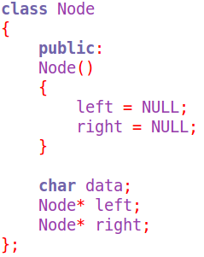
Intro to Trees
D
B
F
A
B
A node will store some data and keep track of its neighbors.
Generally, the left neighbor is less
and the right neighbor is greater

Slide 19
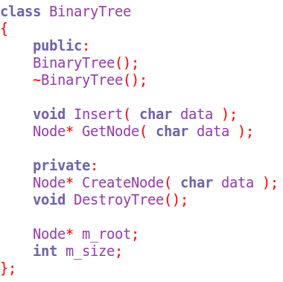
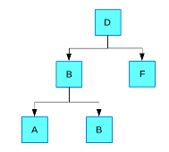
Intro to Trees
Our tree object will store a pointer to the first node:
The root

Slide 20
Intro to Trees
Our tree object will store a pointer to the first node:
The root
The root is the first thing Inserted into the tree.

Slide 21
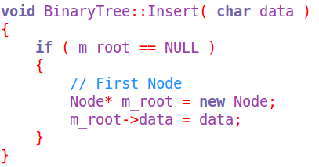
Intro to Trees
First step in an insert function -
If the root is NULL, then the tree is empty.
We create a new Node, that the root pointer will be pointing to.
We also set the value of data to the parameter that was passed into Insert.
Note #1: in the Node class' constructor, it initializes the left and right pointers to NULL.
Note #2: Since we are allocating memory with the new keyword, we will need to make sure to delete this memory in the destructor.

Slide 22
Intro to Trees
If the root isn't NULL, we need to expand this to find a position for the new Node, and set up the new Node.
Implementing this would be easiest with a recursive function.
We're going to cover this information with simple loops first, then have a lecture on recursion, then revisit searching & sorting!

Slide 23
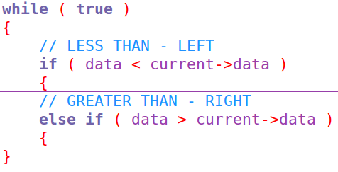
Intro to Trees
To begin traversing the tree, we start at the root.
We will compare the new value to the current element's value, to figure out whether we need to go left or right.

Slide 24
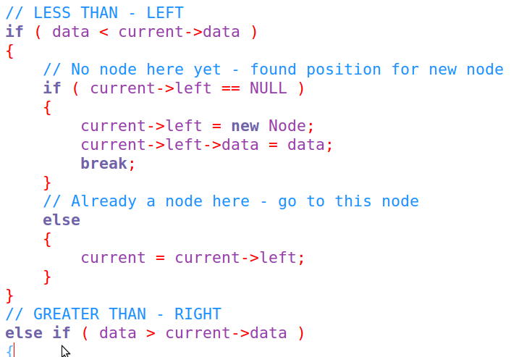
Intro to Trees
If we're going left, but no node is there, we've found the position for our new item.
If we're going left, and there is already a node there, we update our traversal pointer (current), and go back to the beginning of the loop.

Slide 25
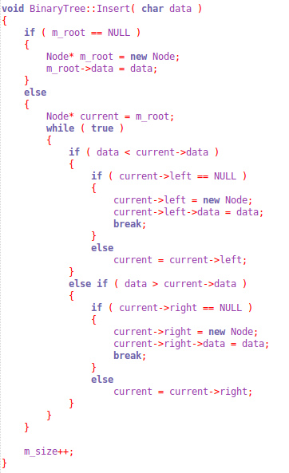
Intro to Trees
This function would be much smaller and simpler with recursion, but hopefully this version gives you an idea of how inserting data into a tree
(and keeping it ordered!) works.
Searching iteratively would work about the same, except instead of searching for a NULL space, you're comparing the node's value to the search term parameter.

Slide 26
Sorting Data

Slide 27
Sorting
Finding data in a data structure is more efficient if we have sorted our data ahead of time.
If the data is unsorted, we could do a linear search or some form of divide-and-conquer, but we can't do more intelligent searches based on the ordering.
Sorting is another area where there are multiple algorithms for sorting our data, and they each have their own trade-offs.

Slide 28

Sorting
The Binary Tree is a data structure that is built to stay sorted, which is enforced by how items are inserted into it.
But we might also need to sort something more linear, like an array, after-the-fact – so that our search will be more efficient.
Let's try one sorting algorithm for now!

Slide 29
Sorting
Some sorting techniques are...
Insertion Sort
Shellsort
Quicksort
Bubble Sort
Heapsort
Bucketsort
Mergesort

Slide 30
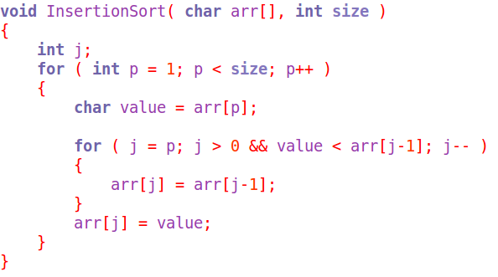
Insertion Sort
With insertion sort,
it iterates over every element of an array (except #0),
“picks it up”, and looks at each element behind it to see if there is a better place for it.
Let's step through the algorithm...

Slide 31
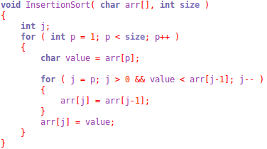
Insertion Sort
0
1
2
3
4
5
Q
W
E
R
T
Y
We start with an array of 6 characters
In the algorithm, we iterate through every element in order, except for #0.
p = 1
Store a backup of arr[p], which is 'W'.

Slide 32
Insertion Sort
0
1
2
3
4
5
Q
W
E
R
T
Y
We start with an array of 6 characters
In the algorithm, we iterate through every element in order, except for #0.
p = 1
The J loop will start at P and go until either:
J is equal to 0, or
The value at P is greater than or equal to the value at J-1.
J-1 = 0,
Arr[J-1] = Q,
Arr[P] = W,
W > Q, so we skip the loop.
j = 1

Slide 33
Insertion Sort
0
1
2
3
4
5
Q
W
E
R
T
Y
p = 2
Next, p is 2, and its value is E.
j = 2
j starts at 2.
Arr[2] = arr[1] (W)
0
1
2
3
4
5
Q
W
W
R
T
Y

Slide 34
Insertion Sort
0
1
2
3
4
5
Q
W
E
R
T
Y
p = 2
Next, p is 2, and its value is E.
j = 1
j is now 1.
Arr[1] = arr[0] (Q)
0
1
2
3
4
5
Q
Q
W
R
T
Y

Slide 35
Insertion Sort
0
1
2
3
4
5
Q
W
E
R
T
Y
p = 2
Next, p is 2, and its value is E.
j = 0
Then after the J for-loop:
Arr[0] = E
0
1
2
3
4
5
E
Q
W
R
T
Y

Slide 36
Insertion Sort
0
1
2
3
4
5
E
Q
W
R
T
Y
p = 3
Next, p is 3, and its value is R.
j = 3
j starts at 3.
Arr[3] = arr[2] (W)
0
1
2
3
4
5
E
Q
W
W
T
Y

Slide 37
Insertion Sort
0
1
2
3
4
5
E
Q
R
W
T
Y
p = 4
Next, p is 4, and its value is T.
j = 3
j is now 3.
Arr[2] = R, Value = T, T > R, loop stops
0
1
2
3
4
5
E
Q
R
W
W
Y

Slide 38
Insertion Sort
0
1
2
3
4
5
E
Q
W
R
T
Y
p = 3
Next, p is 3, and its value is R.
j = 2
j is now 2.
Arr[J-1] = Q, Value = R, R is greater so leave loop
0
1
2
3
4
5
E
Q
R
W
T
Y
Arr[2] = R

Slide 39
Insertion Sort
0
1
2
3
4
5
E
Q
R
W
T
Y
p = 4
Next, p is 4, and its value is T.
j = 4
j starts at 4.
Arr[4] = arr[3] (W)
0
1
2
3
4
5
E
Q
R
W
W
Y

Slide 40
Insertion Sort
0
1
2
3
4
5
E
Q
R
W
T
Y
p = 4
Next, p is 4, and its value is T.
j = 3
j is now 3.
Arr[2] = R, Value = T, T > R, loop stops
0
1
2
3
4
5
E
Q
R
T
W
Y
Arr[3] = T

Slide 41
Insertion Sort
0
1
2
3
4
5
E
Q
R
T
W
Y
p = 5
Next, p is 5, and its value is Y.
j = 5
j starts at 5
j starts at 5
Arr[4] = T, Arr[5] = Y, Y > T, skip the loop
0
1
2
3
4
5
E
Q
R
T
W
Y

Slide 42
Insertion Sort
Before
0
1
2
3
4
5
Q
W
E
R
T
Y
After
0
1
2
3
4
5
E
Q
R
T
W
Y

Slide 43

Searching & Sorting
That was a brief introduction to searching and sorting.
We will cover more on this topic after we look at recursion!
Though for many cases, you will end up utilizing someone else's sort function
(such as from the standard library)
since they will be more optimized,
and why reinvent the wheel?
If you think this is interesting,
good for you!
I'm going to go take a nap now.

